Slide 1




Ministry of Electronics & Information Technology
National Informatics Centre
Kerala State Centre
K-SWIFT
Single Window Interface for Fast & Transparent Clearance
Integrating Agriculture EODB services
A Joint Initiative of KSIDC, Govt. of Kerala & National Informatics Centre

Slide 2

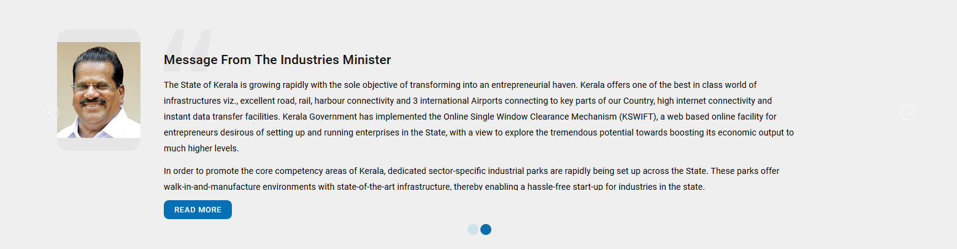
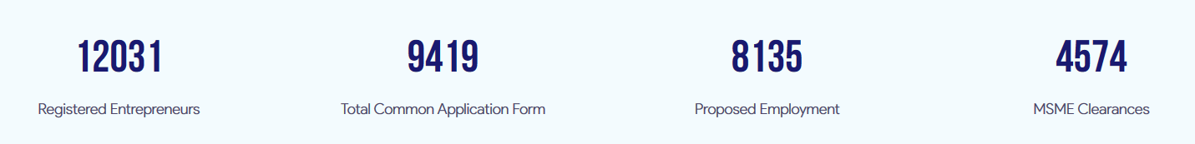

K-SWIFT
www.kswift.kerala.gov.in
K-SWIFT (Kerala - Single Window Interface for Fast and Transparent Clearance) facilitates ease of doing business using ICT tools by integrating all the line departments using open API to bring under common platform.
K-SWIFT is a unified integrated platform for entrepreneurs to apply for all requisite clearances to start industry without any procedural delays in getting statutory clearances from various authorities concerned throughout the life cycle of projects.

Slide 3
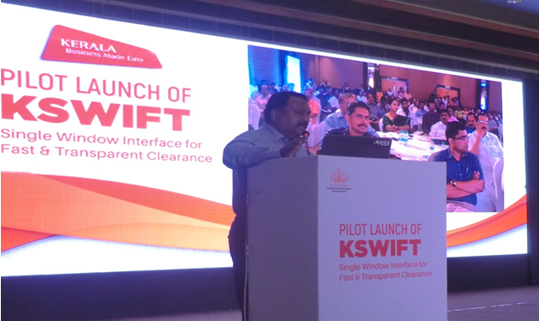
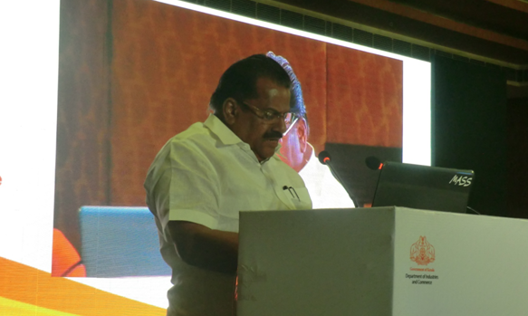
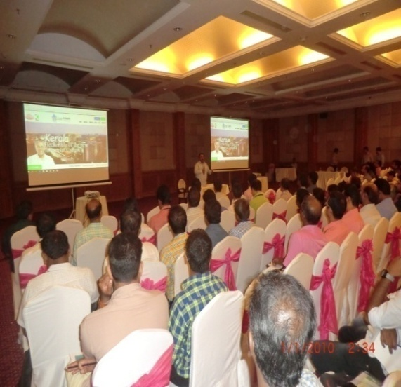
K-SWIFT
www.kswift.kerala.gov.in
Single Point Contact for Entrepreneurs across multiple departments
One Stop repository for all Govt. notifications for Investors / Entrepreneurs
Common Application form (CAF)
Eliminating multiple point of contacts
Automated Fees calculation by the System against each Service.
Payment gateway integration
Real time notifications and Alerts via e-mail, SMS & Dash board.
Online tracking of Applications
Grant of clearances in parallel
Approval within fixed Time limit
Deemed approval
Self certification for MSME
Downloadable Digital Approvals
Digital Composite License binding all the Departments
Objectives

Slide 4

K-SWIFT
www.kswift.kerala.gov.in
Benefits
Know your clearances
Online submission through CAF
One time document submission with CAF
Advisory in start of each stage
Multiple statutory payments in one go through Online Payment Gateway
Paperless filling
Online processing
Cash less, paperless, contactless
Single Level of approval
Provides single point of contact
Deemed Approval to reduce delays
Stages and timeline defined
Pre-cleared industrial sites
Graphical Reports & MIS for Management
Online Business Query Interface
Land Bank Information
Real time status tracking through SMS, Email
Inter-department communication Mechanism
DSC integration

Slide 5
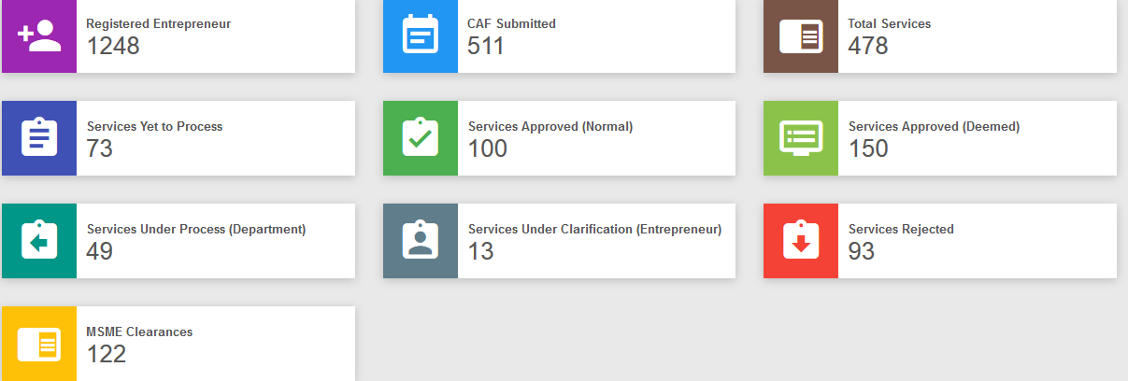
K-SWIFT
www.kswift.kerala.gov.in
G2E
G2C & G2B
G2G
Online application form
Roll based dashboard
e-Alert/notice board, send clarification
Application trend
Stage wise dept status
MIS reports
DSC
Single signup
CAF
Deemed certificate
Composite certificate
Application trend
Stage wise Dept. status of application
Reduce time line
Cash less,
Faceless
Contactless
Dashboard
e-Alert/notice board, clarification
End to end solution
e-Payment
e-Review
Platform
Business Reform Action Plan move from Aspirers to Fast Movers category.
Reduce time line
Cash less,
Faceless
Contactless
Dashboard
e-Alert/notice board, clarification

Slide 6
KSWIFT
www.kswift.kerala.gov.in
BENEFITS TO OFFCERS
E-application form
Roll based dashboard
E-alert/notice board, send clarification
Application trend
Stage wise dept status
MIS reports
DSC

Slide 7

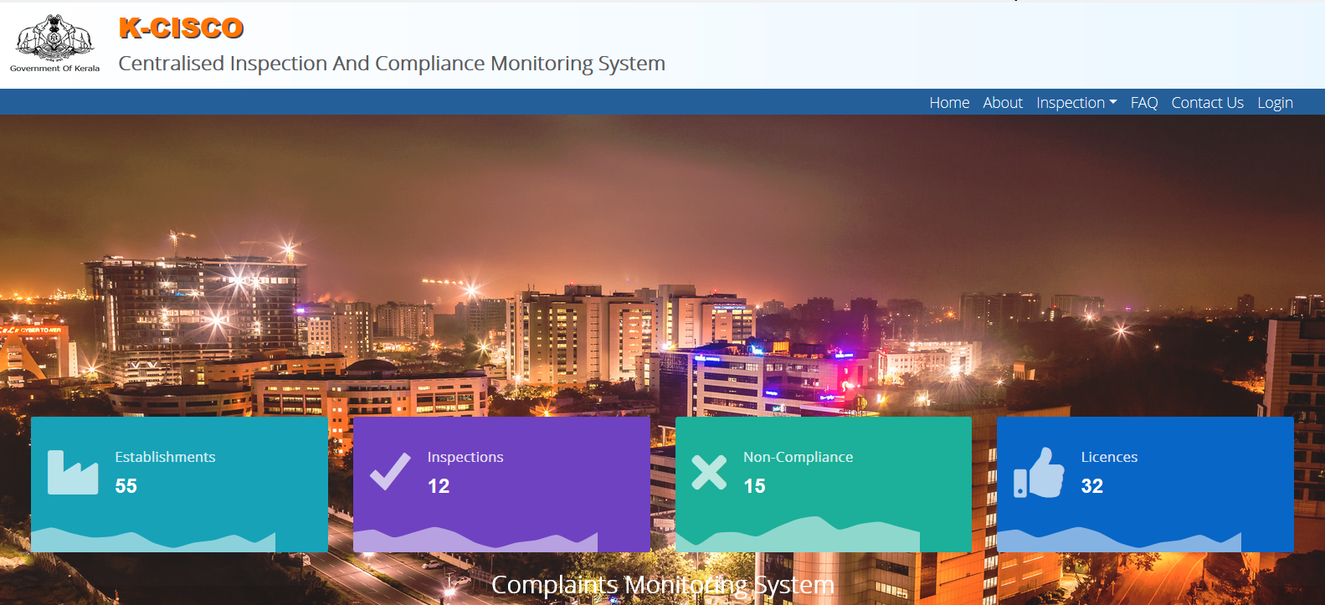
K-SWIFT
www.kswift.kerala.gov.in
MSME
For empowering the MSME entrepreneurs, easy application process and auto generation of Acknowledgement certificate.
Automatic clearances will be given to an Entrepreneur whose capital investment is below 10 Cr. The Entrepreneur has to get the required clearances within Three years after getting the automatic clearance of MSME Act.
Reminder system for obtaining approvals within a time period and roll based dash board for stakeholders
Centralised Inspection System
Develop transparent checklists and procedures.
Dynamic CIMC from onboarded line depts
Ensure synchronized inspections of Departments
Establish the system for risk based inspections
Develop modalities for conducting surprise inspections
Empanel third party inspector, wherever applicable.

Slide 8

K-SWIFT
www.kswift.kerala.gov.in
Functionalities
Entrepreneur registration
Common Application form (CAF)
Mapping services with line departments
Open API/ Web service Integration with Line departments
Work flow for Non ICT departments
e-Payment (Treasury and Federal bank)
DSC integration
e-Mail / SMS notification
Tracking application
Deemed/ Composite license
Roll based dashboard
MIS/ Analytical reports
MSME

Slide 9
K-SWIFT
www.kswift.kerala.gov.in
ICT Approach
Integrated 14 Departments / Agencies in Ver 1.0
Single Sign On (ICT Depts. having On line Appl.)
Electrical Inspectorate
Pollution Control Board
Factories & Boilers
Labour
Mining & Geology
Fire & Rescue
State Environment Impact Assessment Authority (SEIAA)
Web Services (ICT Depts. sharing the Data)
KSEB
KWA
User Interface (Non ICT Depts. )
Town Planning
LSGD (Urban)
LSGD (Rural)
Forest
GWD
e
14 Departments / Agencies
e
35 Services
e
2 Payments Gateways

Slide 10
K-SWIFT
www.kswift.kerala.gov.in
Service Mapping ver1.0
SL No | Department | Service
1 | Factories & Boilers | Permit for Constructing New Factory under Section 85
 |  | Permit for Constructing New Factory under Section 2m
 |  | Factory License
 |  | Boiler Registration
2 | Fire & Rescue | Consent to Establish
 |  | Consent to Operate
3 | Electrical Inspectorate | Electrical Scheme Approval
 |  | Issue of Safety Certificates
4 | KSPCB | Consent to Establish
 |  | Consent to Operate
5 | T & CP | Layout Approval
6 | LSGD (Urban) | Building Permit
 |  | Development/Redevelopment Permit
 |  | Corporation/Municipality License
 |  | Occupancy Certificate
7 | LSGD (Panchayat) | Building Permit
 |  | Development/Redevelopment Permit
 |  | Panchayat License
 |  | Occupancy Certificate
SL No | Department | Service
8 | Labour Department | Registration of Shops and Establishments
 |  | Registration for Contract Labour
 |  | Registration for Building and Other Construction Workers
 |  | Registration for Inter State Migrant Workmen
 |  | Registration of Principal Employer under Contract Labour Act 1970
9 | Mining & Geology | Quarrying Permit For Ordinary Earth Removal
10 | SEIAA | Environmental Clearance
11 | Forest & Wildlife | License for Sawmill and other wood based industrial units
 |  | Permission for cutting and transportation of Trees
12 | KSEB | Electricity Connection (LT/HT)
13 | KWA | New water connection
14 | Ground Water | Ground water investigation
 |  | Pumping test

Slide 11
K-SWIFT
www.kswift.kerala.gov.in
ICT Approach
Integrate 12 Departments / Agencies in Ver 2.0
As per the recommendation from Government of India (GoI) in order to avail additional borrowing, the State is required to onboard 12 Departments in KSWIFT portal to obtain NOC to do business in a easy way .
e
12 Departments / Agencies
e
15 Services
Single Sign On (ICT Depts. having On line Appl.)
Web Services (ICT Depts. sharing the Data)
User Interface (Non ICT Depts. )
Agriculture **
e
2 Payments Gateways
Revenue, Registration, KCZMA, Food & safety, Excise, GST, Health, Home, Drugs Control, Tourism, District Administration, Gen.Education

Slide 12
K-SWIFT
www.kswift.kerala.gov.in
Service (2*3) Mapping ver2.0
SL No | Department | Service
1 | Agriculture | 1. License to Whole / Manufacturers/ Retailers – Insecticides
 |  | 2. License- Whole / Manufacturers/ Retailers - FERTILIZER MIXTURES
 |  | 3. Renewal of LC - Insecticides
 |  | 4. Renewal of LC Fertilizer mixtures
 |  | 5. Other services – change premises, change of ownership, Additional / Deletion of Raw Materails/ Fertilizers <service oriented>

Slide 13
K-SWIFT
www.kswift.kerala.gov.in
Service (2*3) Mapping ver2.0
SL No | Department | Service
2 | General education | NoC for setting up CBSE School
 |  | Registration of schools under Right to Education

Slide 14
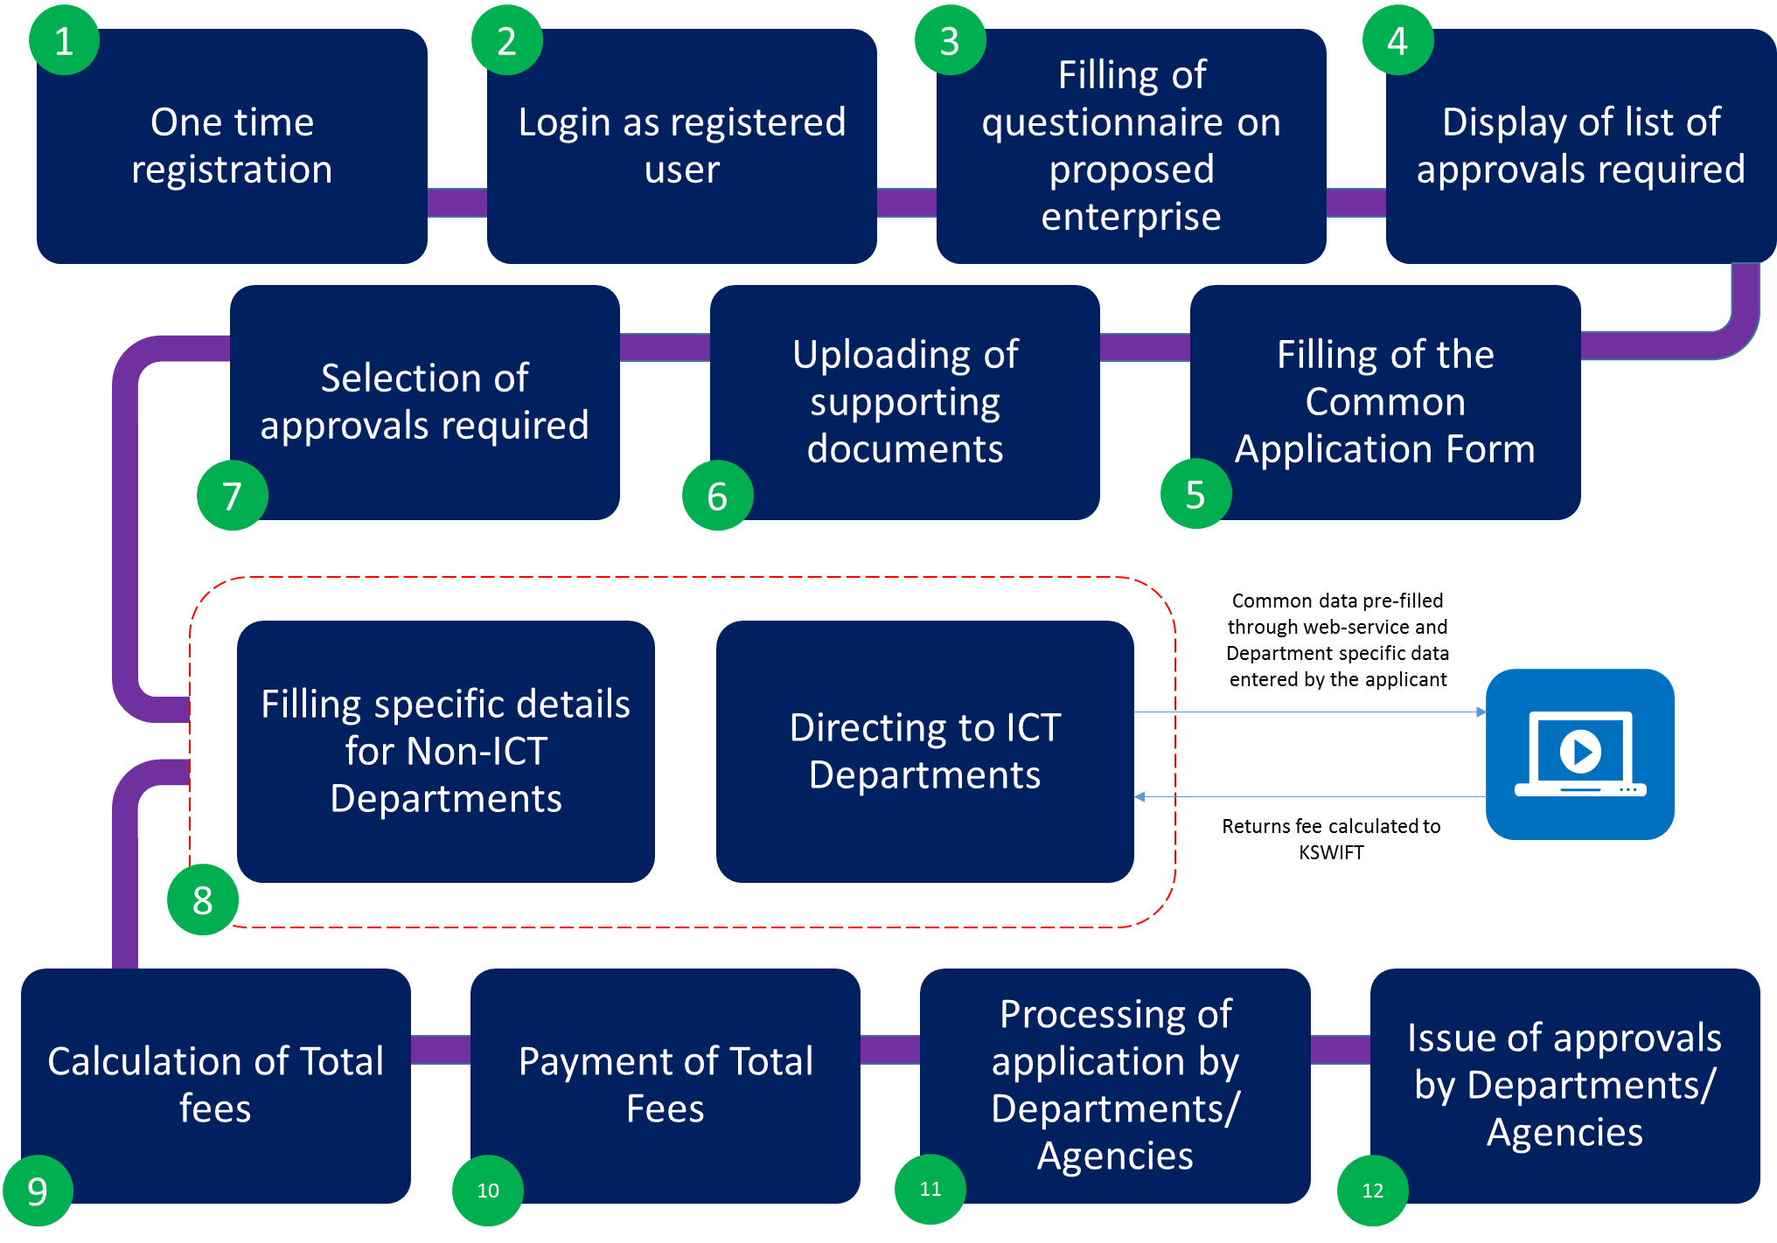
K-SWIFT
www.kswift.kerala.gov.in
Generic Process flow

Slide 15
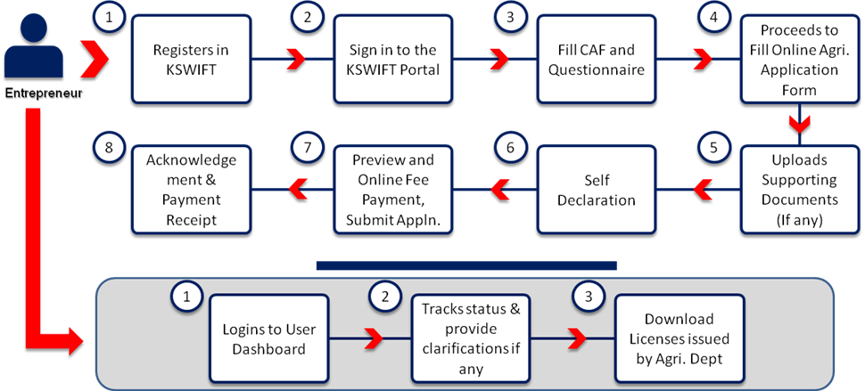
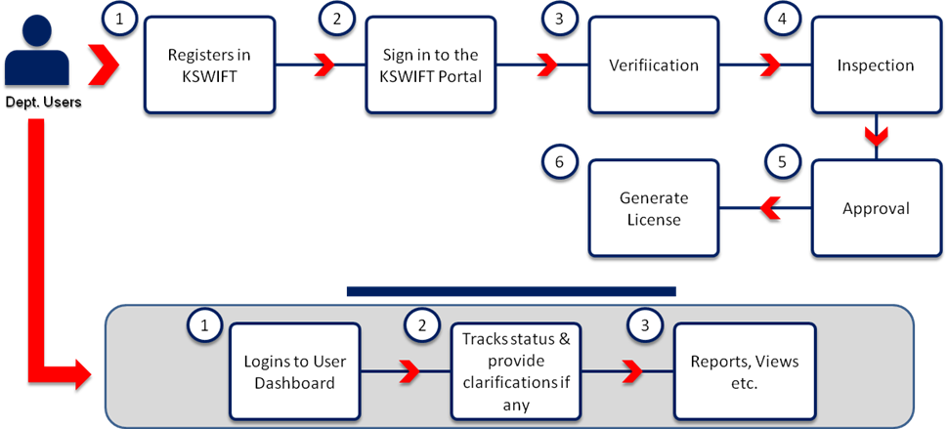
K-SWIFT
www.kswift.kerala.gov.in
Agriculture Process flow
8 Steps
Agriculture Dept.
6 Steps

Slide 16




Process flow (Fertilizers)
KB level Officer
2
1
4
3
5
Issuing LC
to Whole sale & Manufacturers
Block
level Officer
1
If inspection team is not satisfied , application will be returned to the applicant to rectify
Appl. Submission
KSWIFT
District
level Officer
Issuing license
Issuing suitability
& lab facility certificate
Inspection team
State Level Final approval authority

Slide 17
Process flow (Fertilizers)
KB level Officer
2
1
4
3
5
Issuing LC
to Retailer (Fertilizers)
Block
level Officer
1
If inspection team is not satisfied , application will be returned to the applicant to rectify
Appl. Submission
KSWIFT
District
level Officer
Issuing license
Issuing suitability
certificate
Inspection team
District Level Final approval authority
(DDA (E&T)

Slide 18
Process flow (Insecticides)
KB level Officer
2
1
4
3
5
Issuing LC
to Manufacturers & Whole sales (Insecticides )
Block
level Officer
1
Appl. Submission
KSWIFT
District
level Officer
Issuing license
Issuing suitability
& lab facility certificate
Inspection team
State Level Final approval authority
(JDA(PP)

Slide 19
Process flow (Insecticides)
KB level Officer
2
1
4
3
5
Issuing LC
to Retailer (Insecticides)
Block
level Officer
1
Appl. Submission
KSWIFT
District
level Officer
Issuing license
Issuing suitability
certificate
Inspection team
District Level Final approval authority
(DDA (E&T)

Slide 20
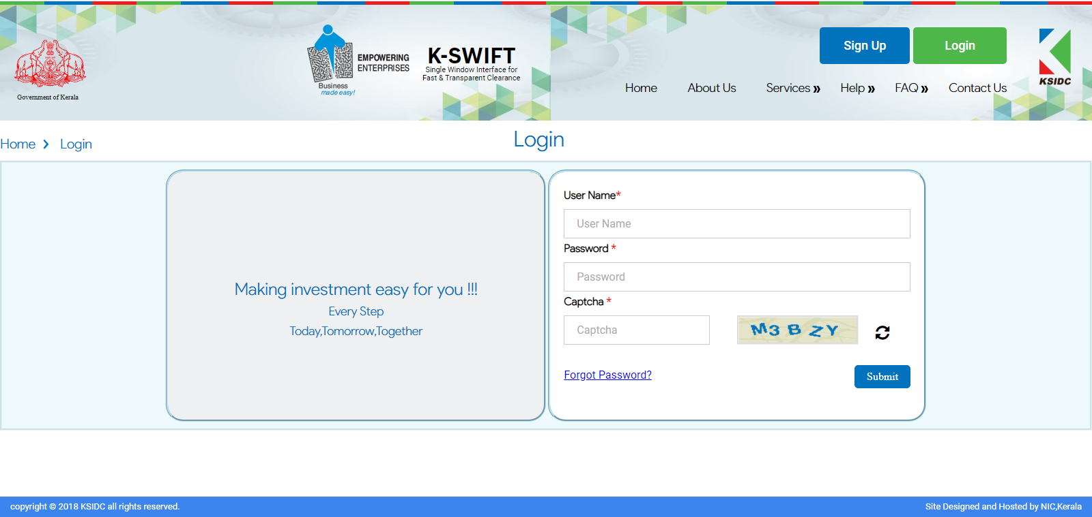


Sample 8
After the first Login, System will prompt to change the Password.
Login Page
Entrepreneur

Slide 21
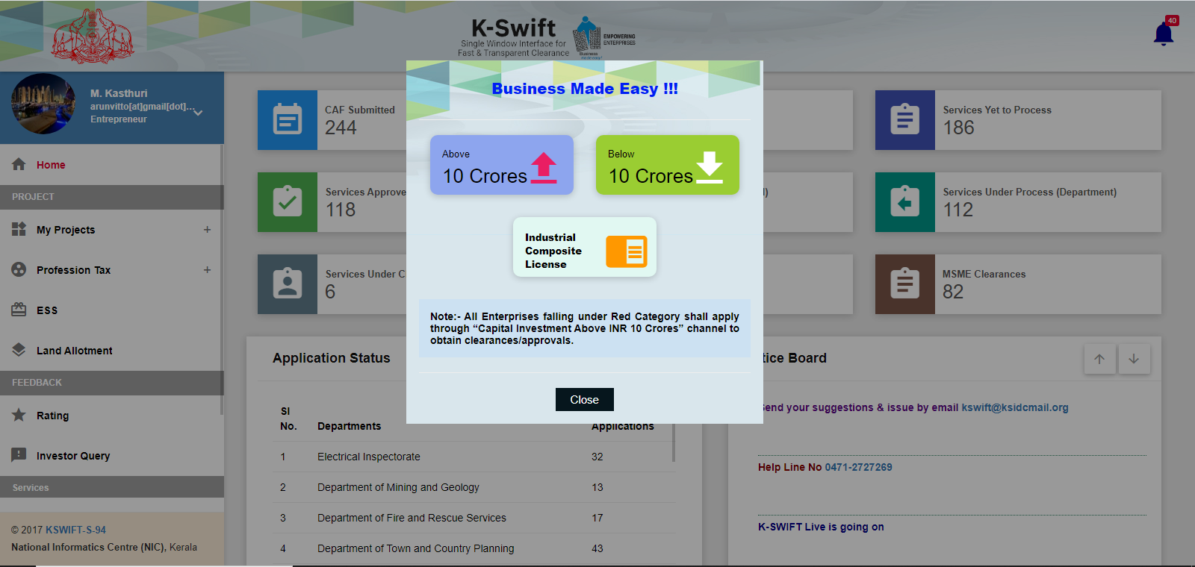
Sample 8
Home Page

Slide 22
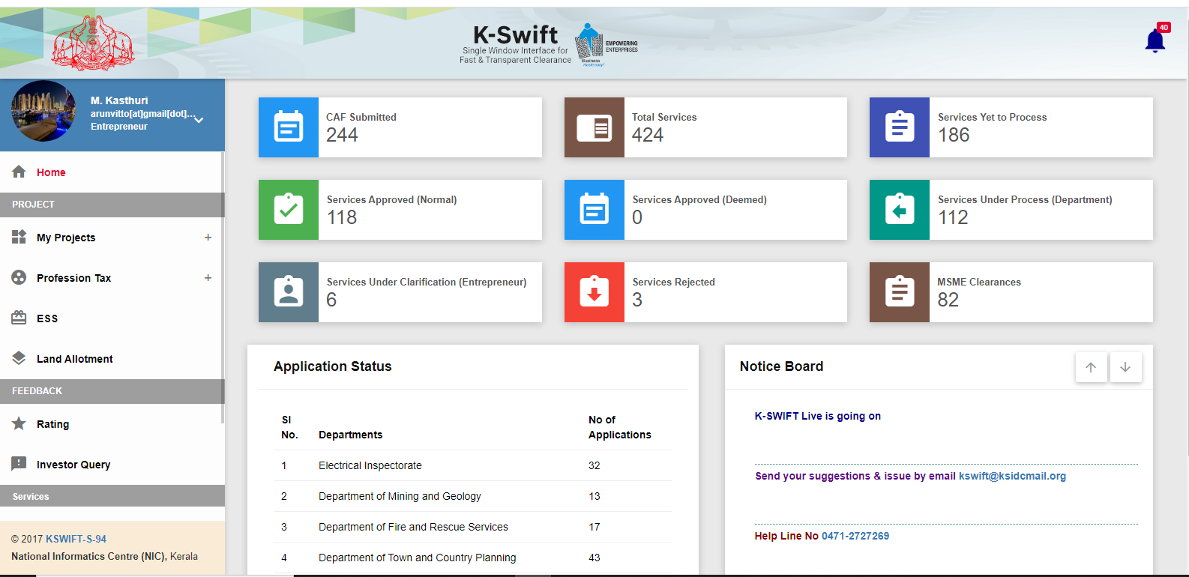
Sample 8
Home Page

Slide 23
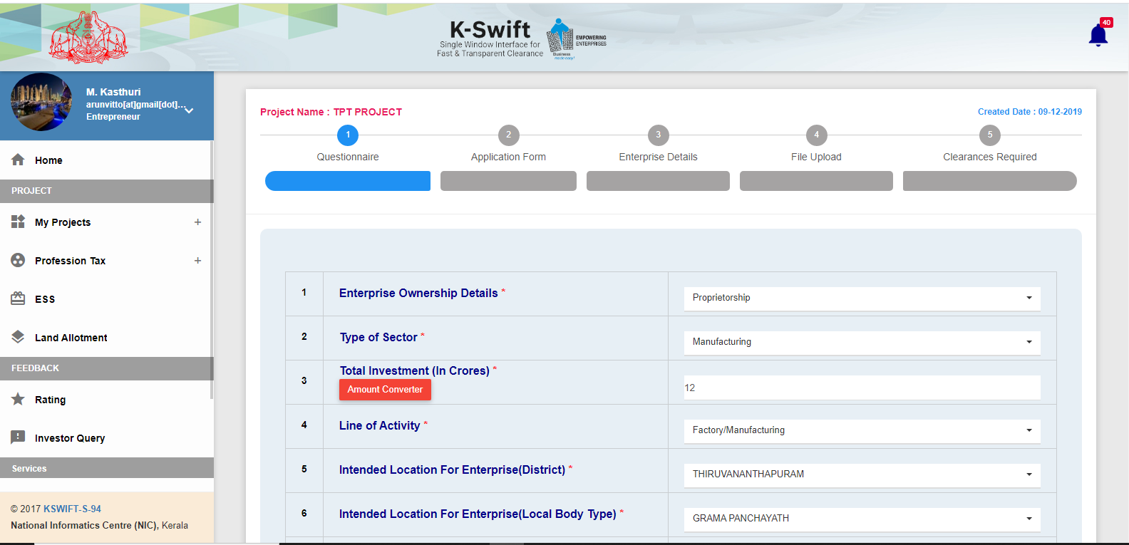
Questionnaire

Slide 24
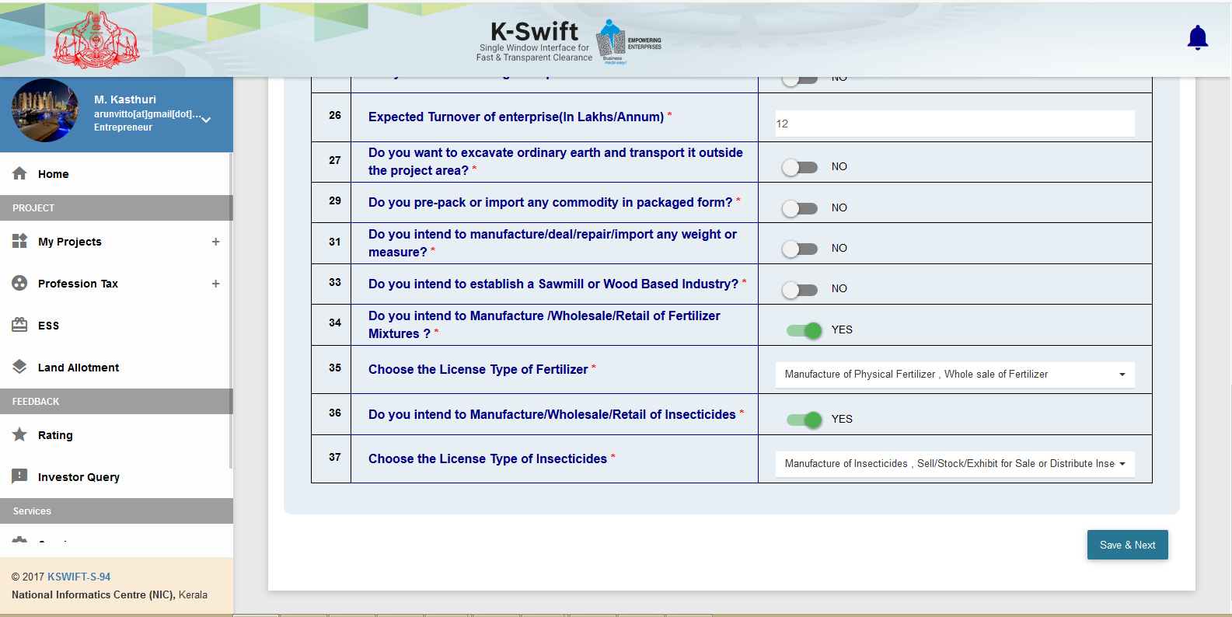
Questionnaire
Agriculture Service related

Slide 25
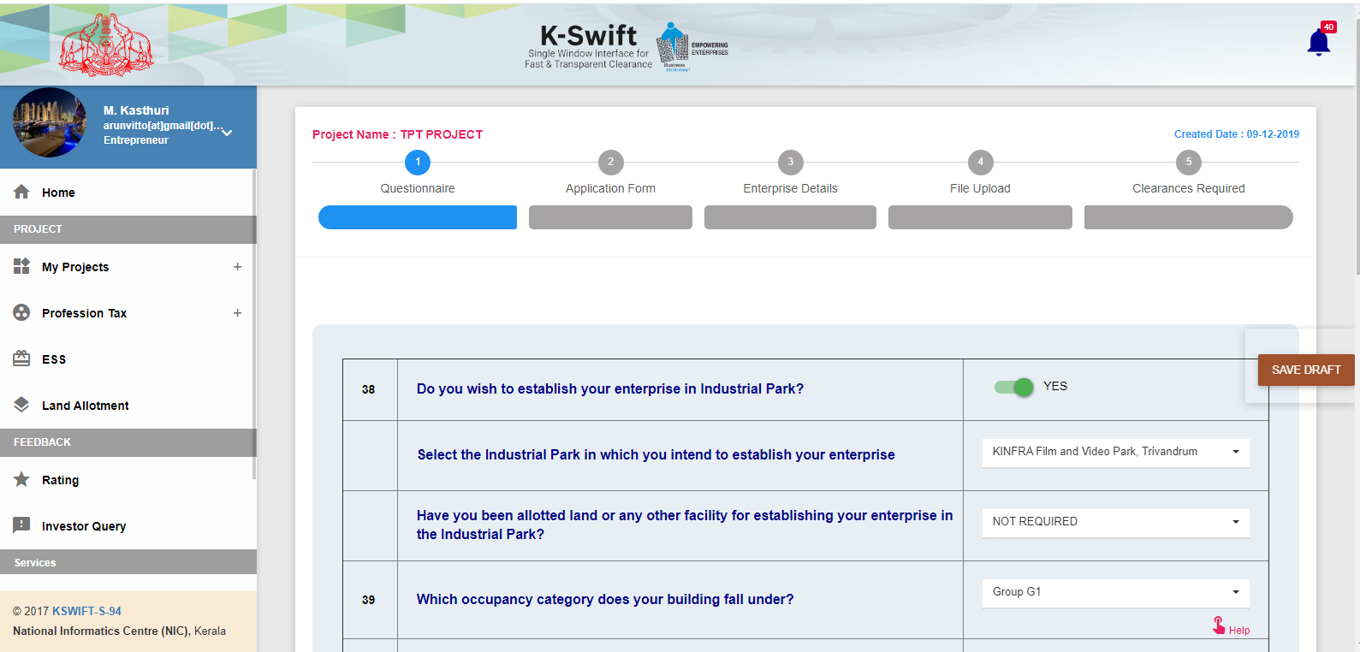
Questionnaire
41 Questions

Slide 26
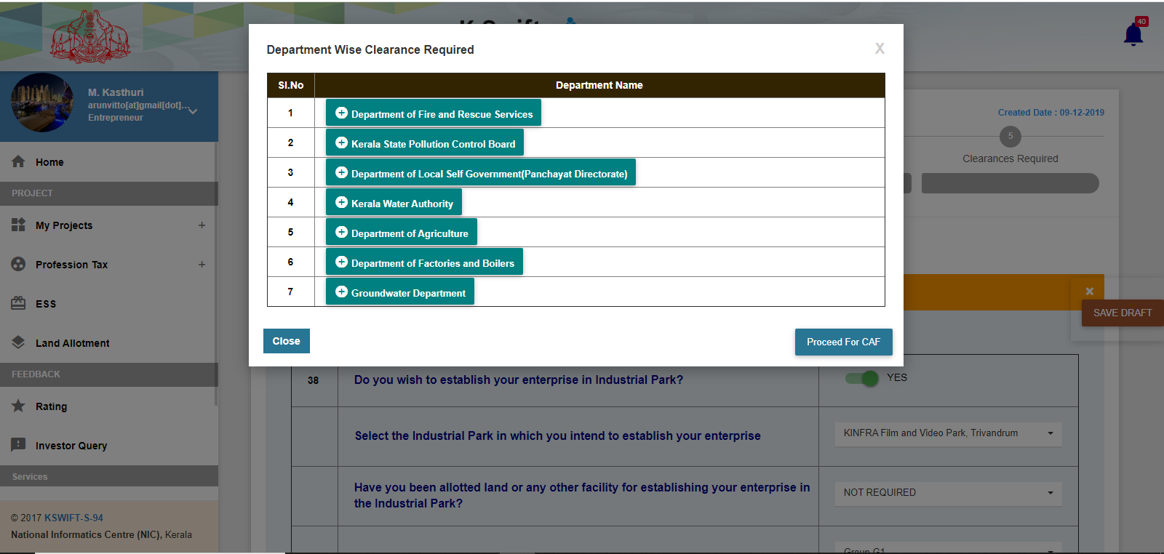
Clearance Req. Dept. List

Slide 27
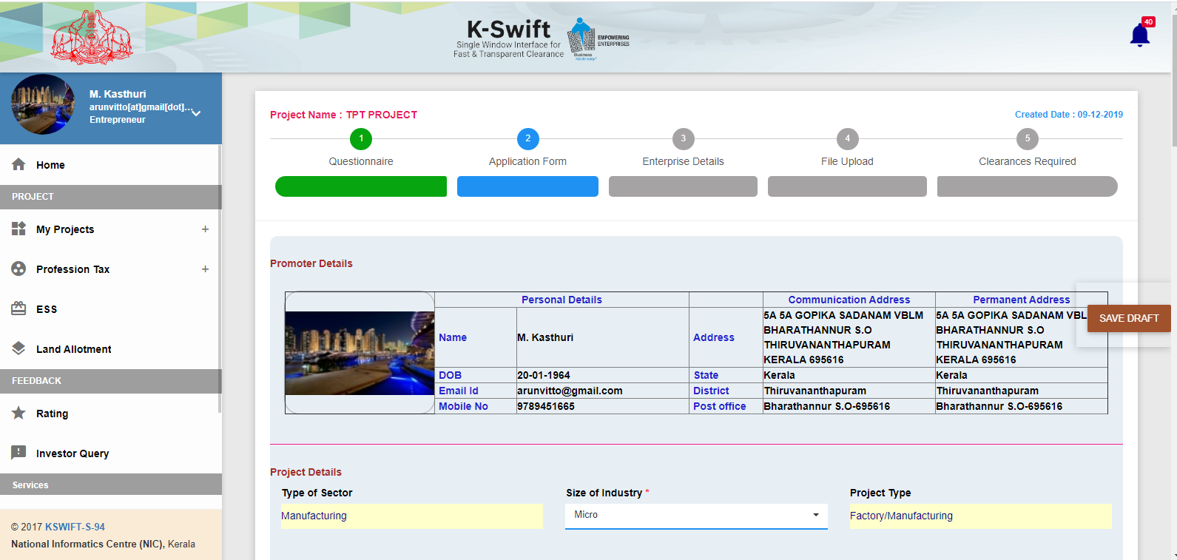
CAF

Slide 28
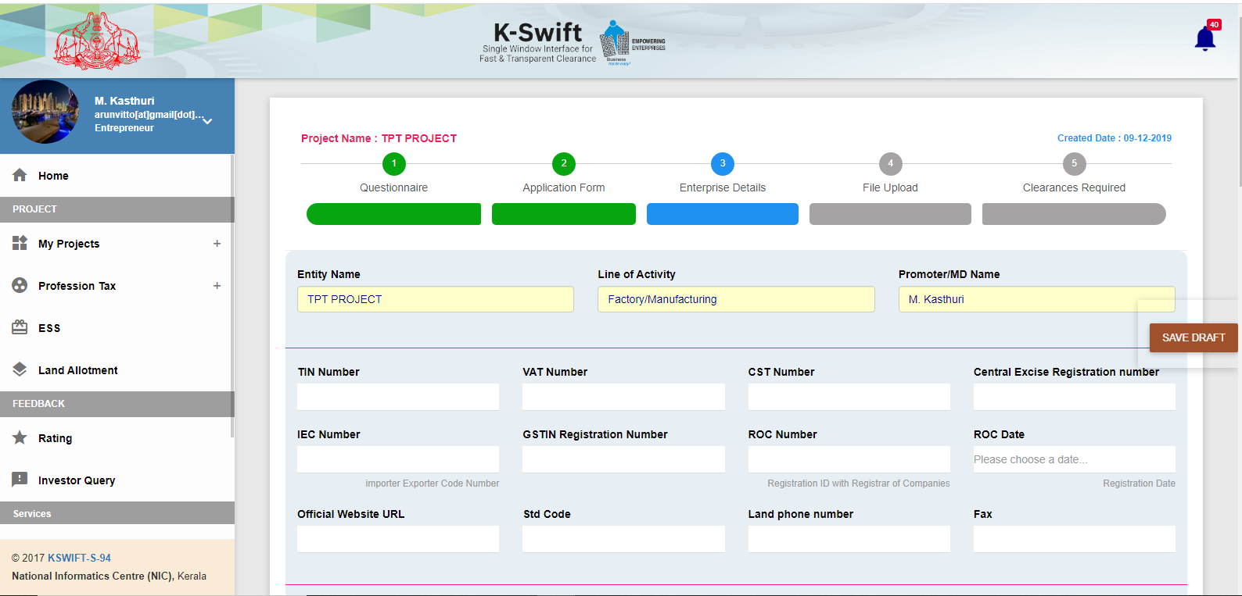
Enterprise Details

Slide 29
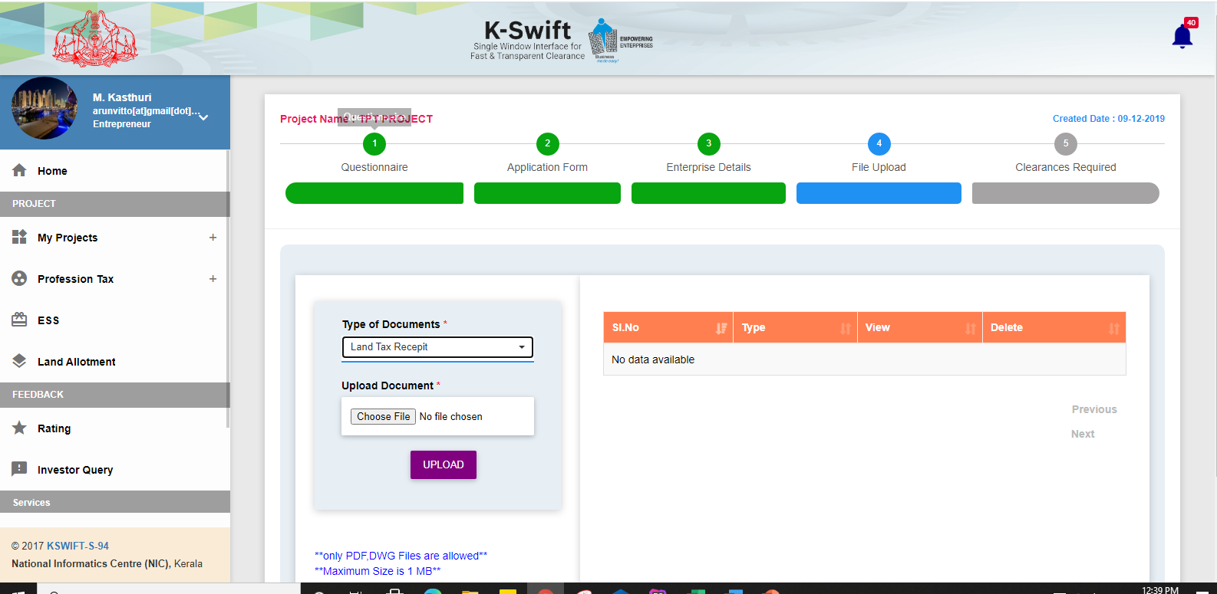
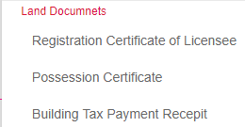
File Upload

Slide 30
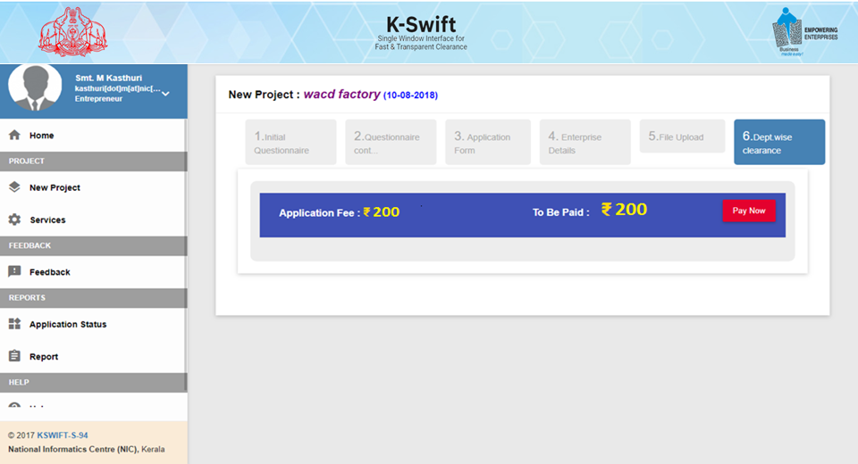
Appl. Fee (KSIDC)
Application Fee: One time Payment for a Project
Rs. 200/- for Capital Investment below 15 Cr and all others Rs.500/-

Slide 31
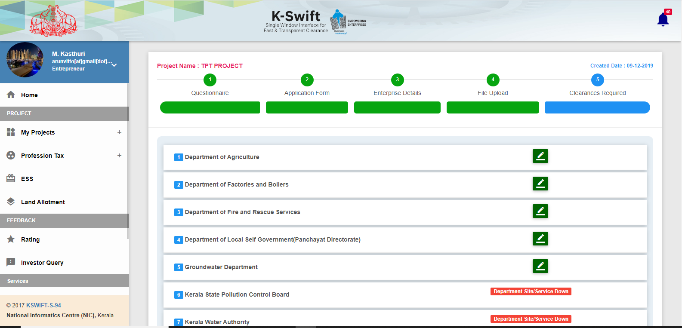
Dept. list to Choose

Slide 32
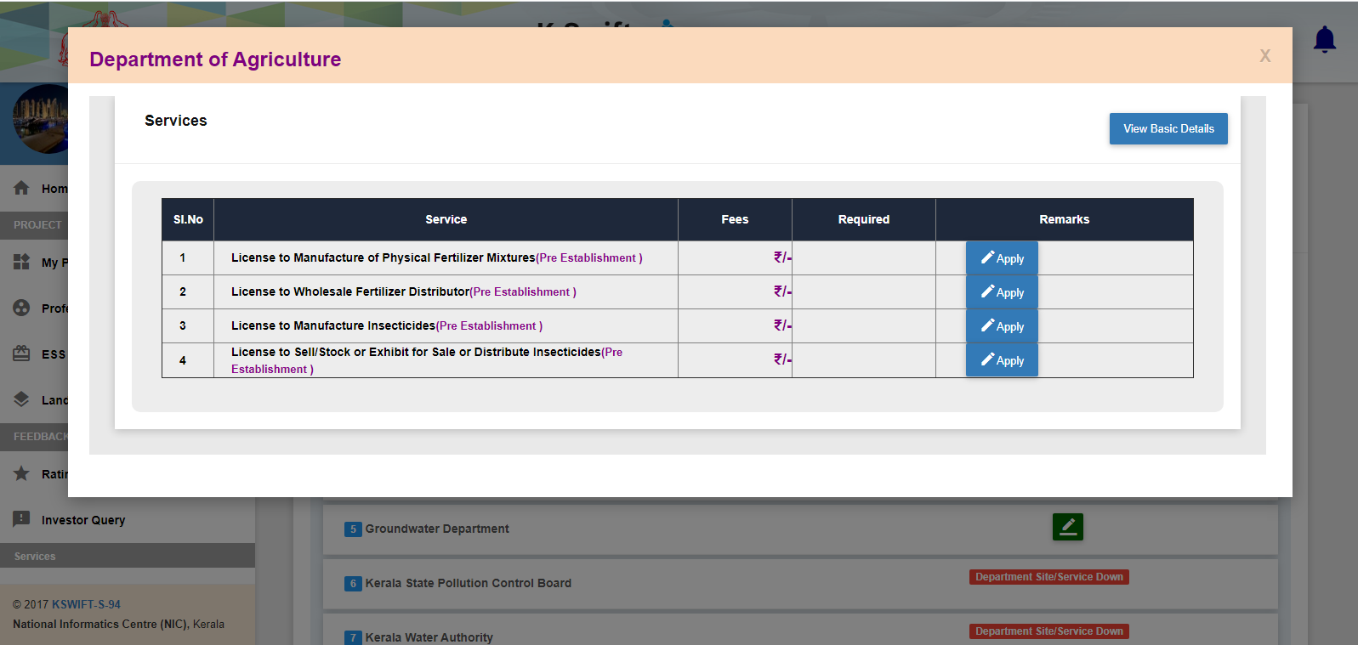
Dept. Services
Agri services

Slide 33
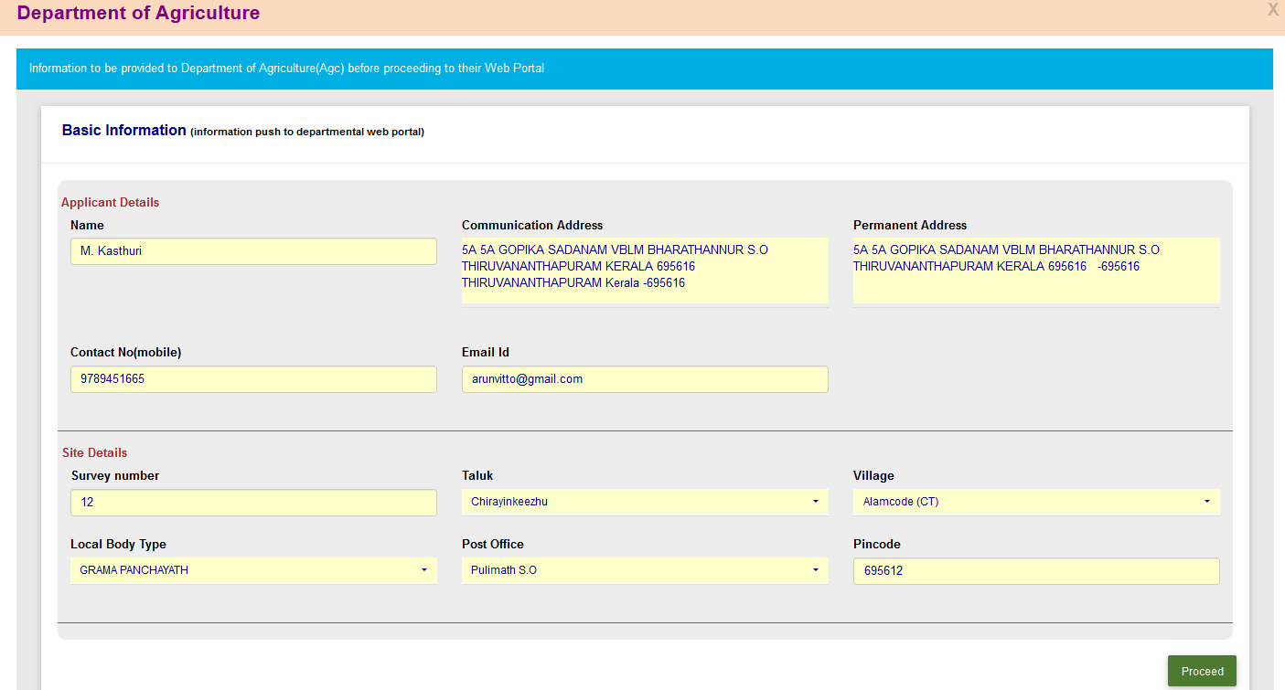
Agri services

Slide 34
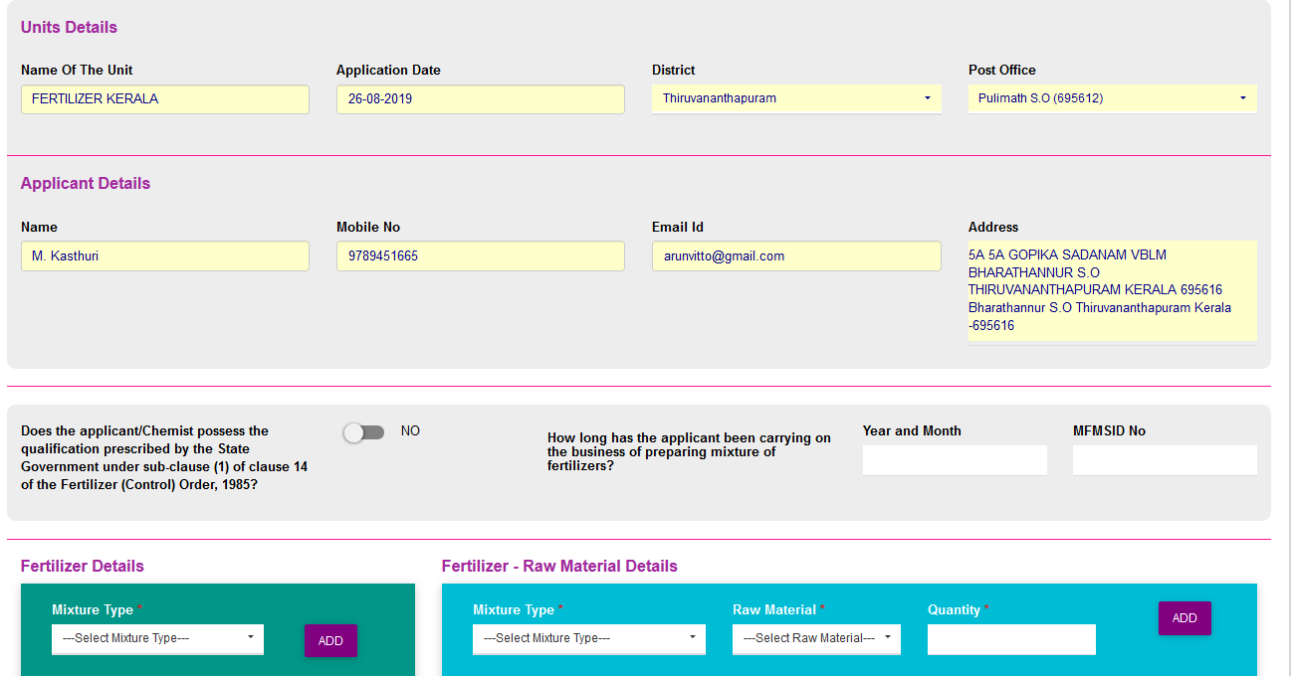

Slide 35
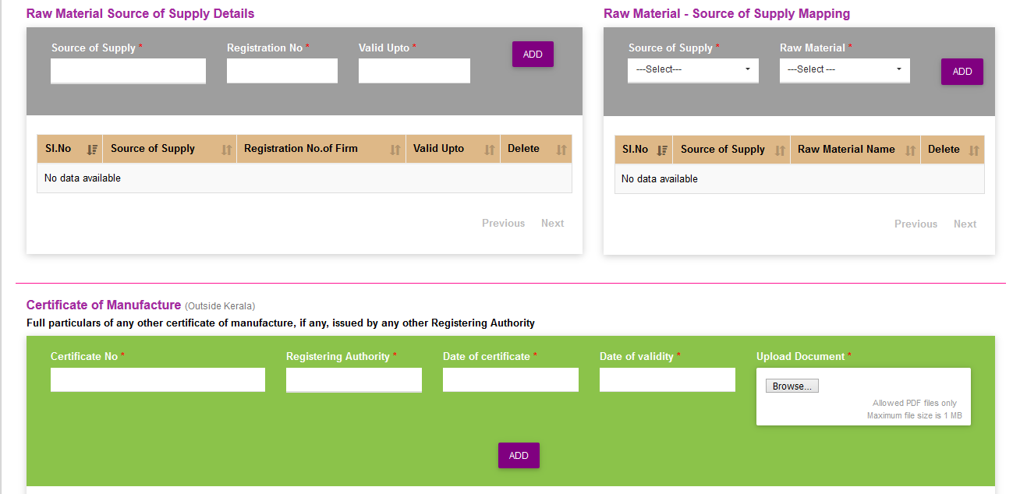

Slide 36
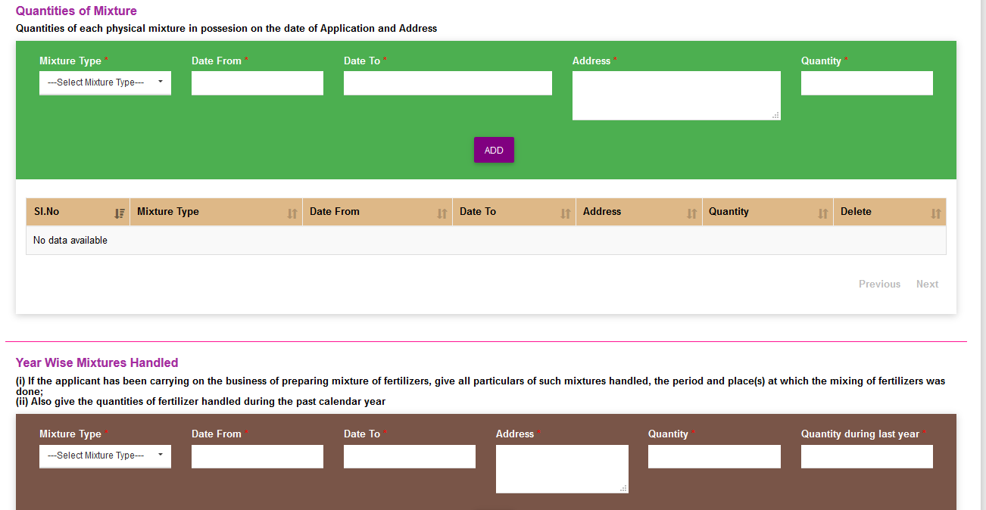

Slide 37
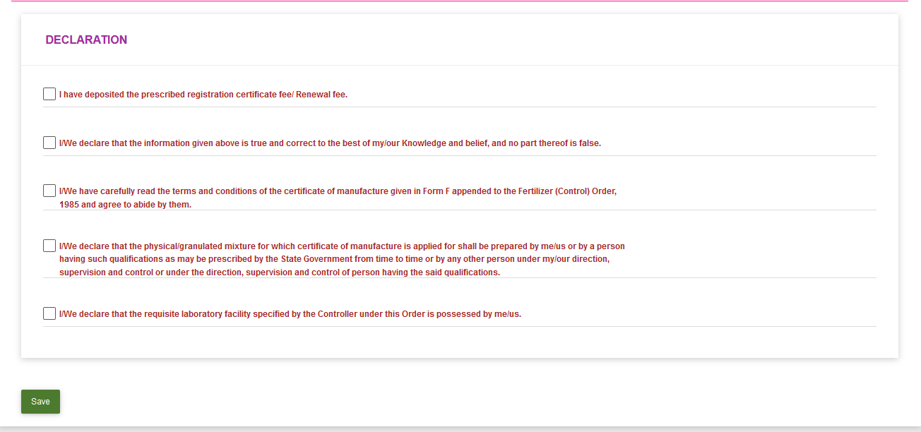

Slide 38
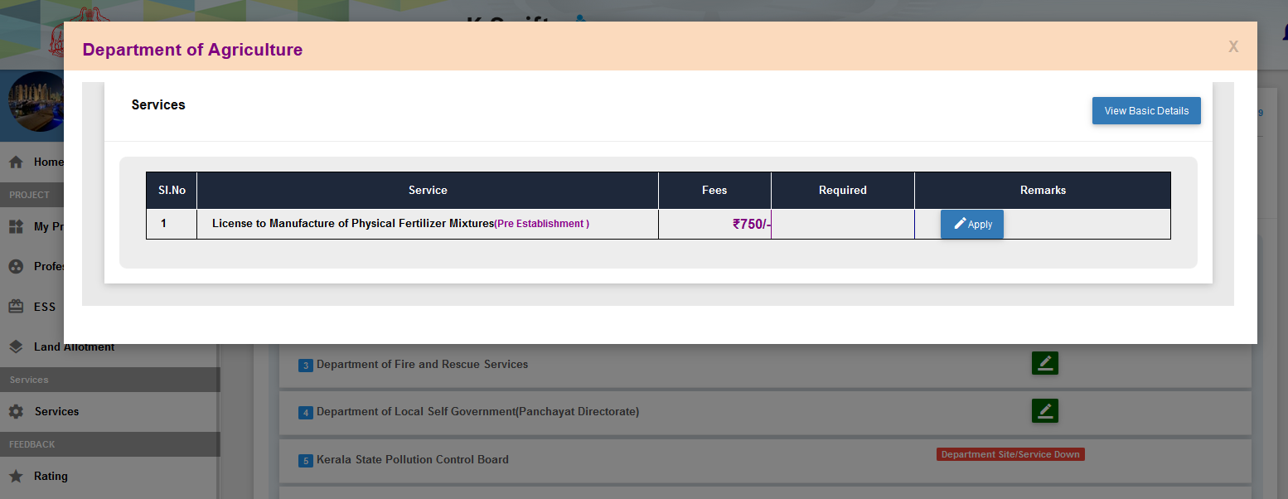

Slide 39
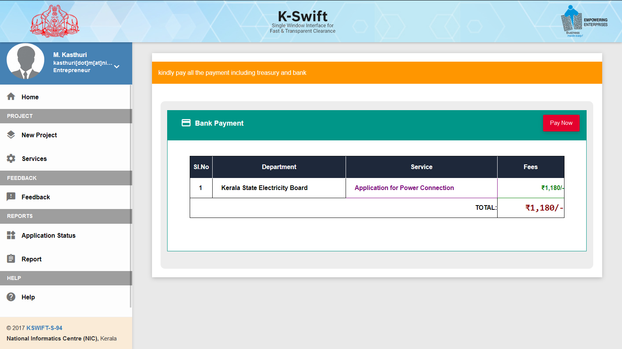
ePayment

Slide 40
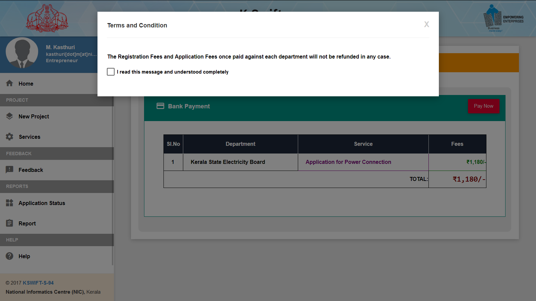
Payment

Slide 41
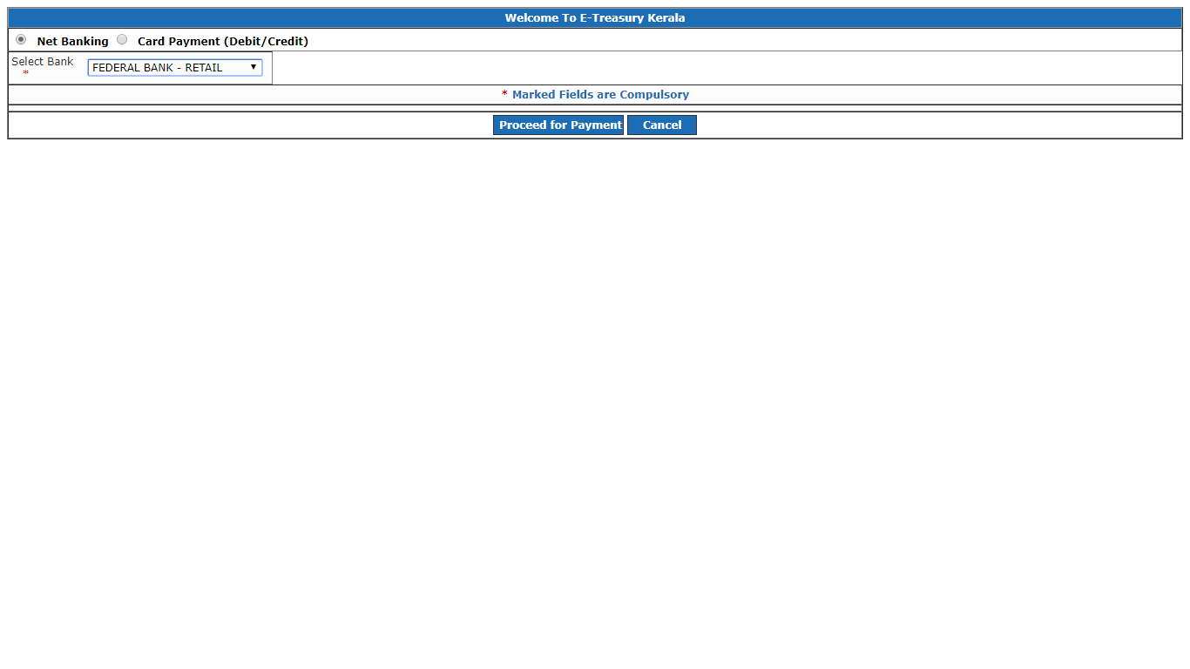
Payment

Slide 42
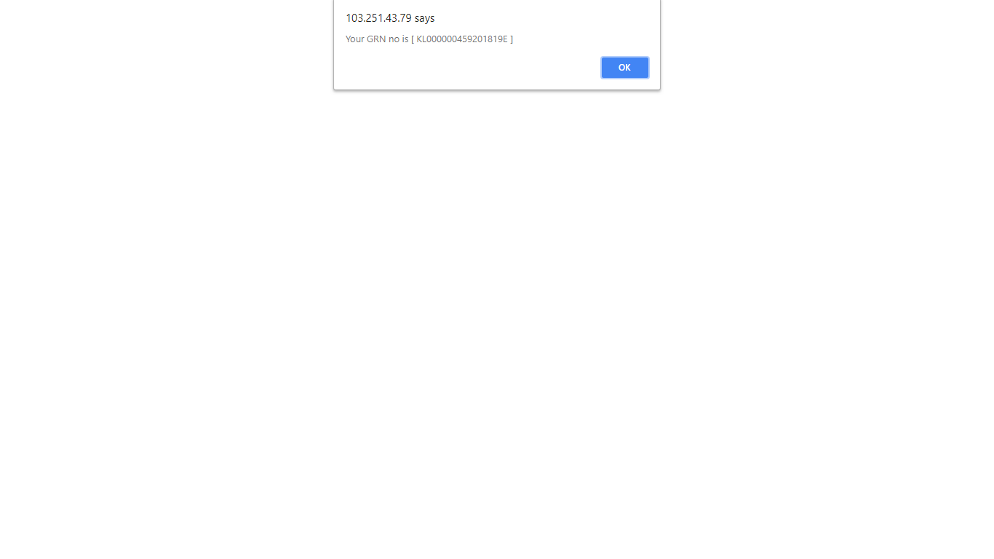
Payment

Slide 43
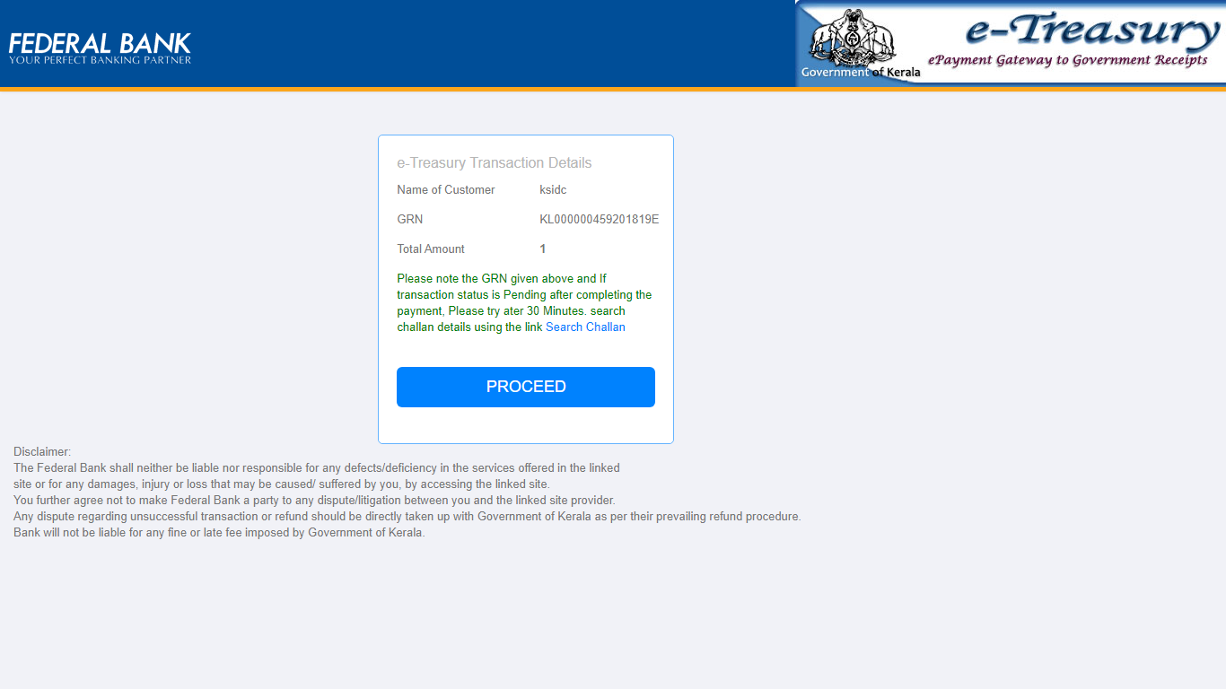
Payment

Slide 44
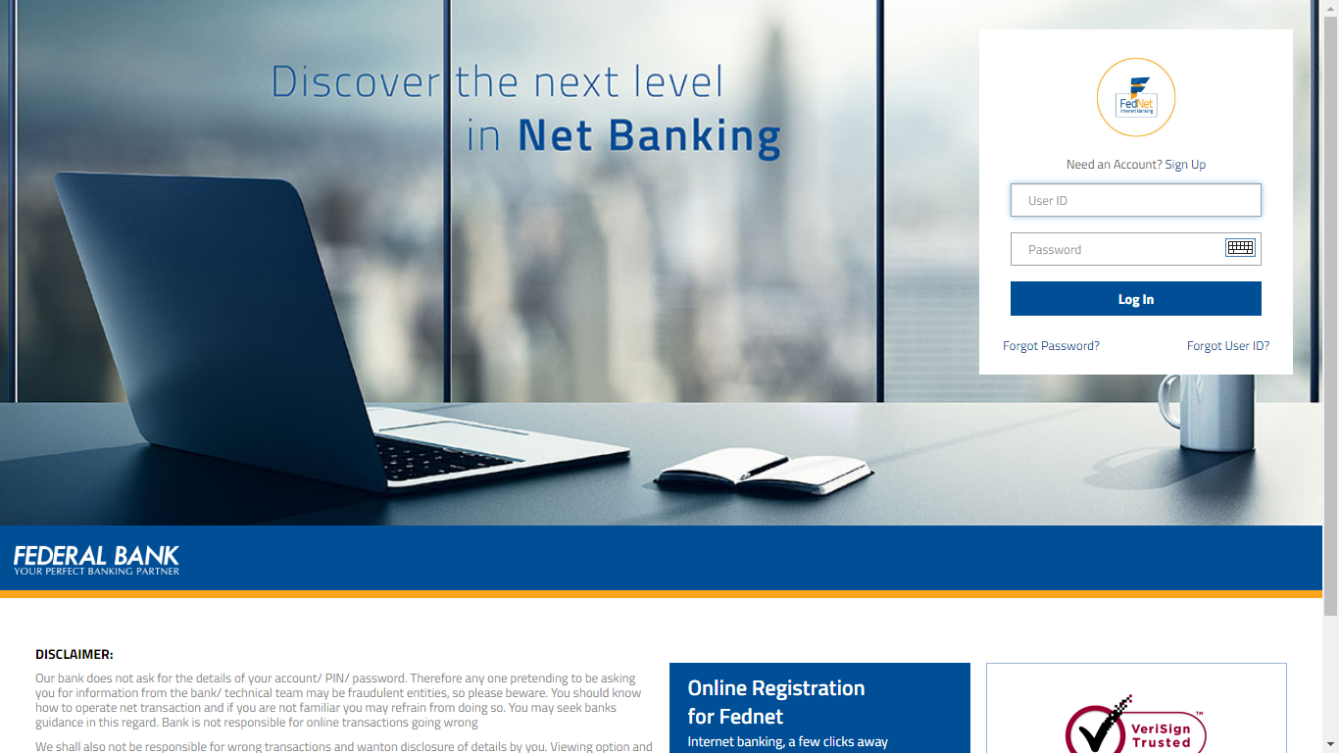
Payment

Slide 45
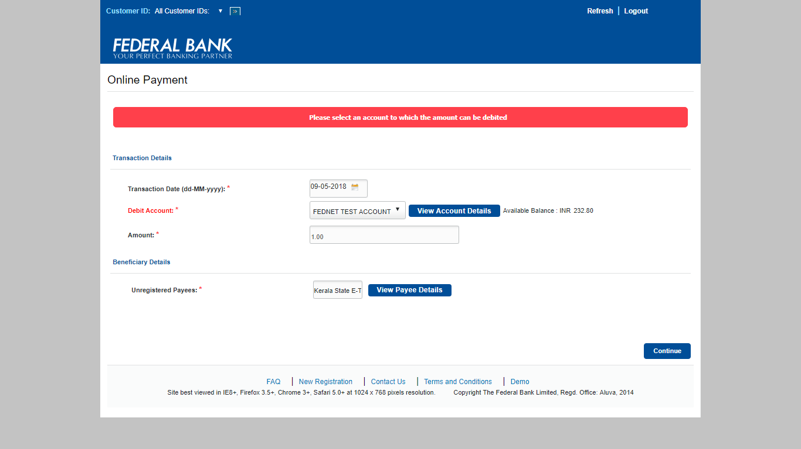
Payment

Slide 46
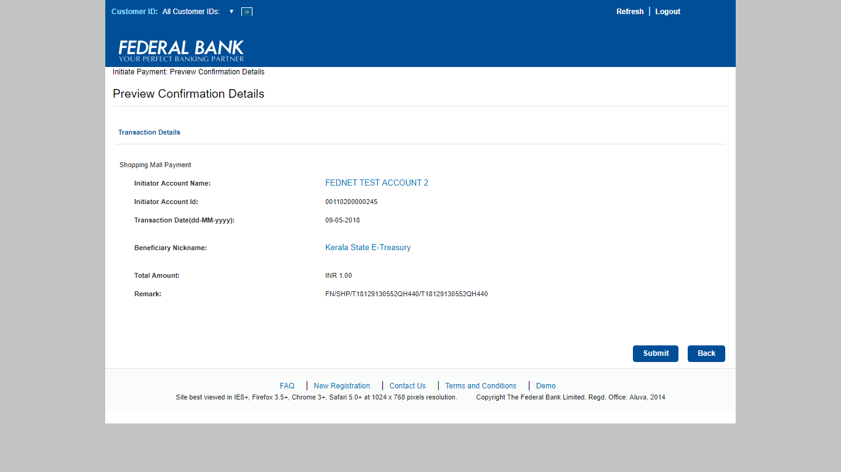
Payment

Slide 47
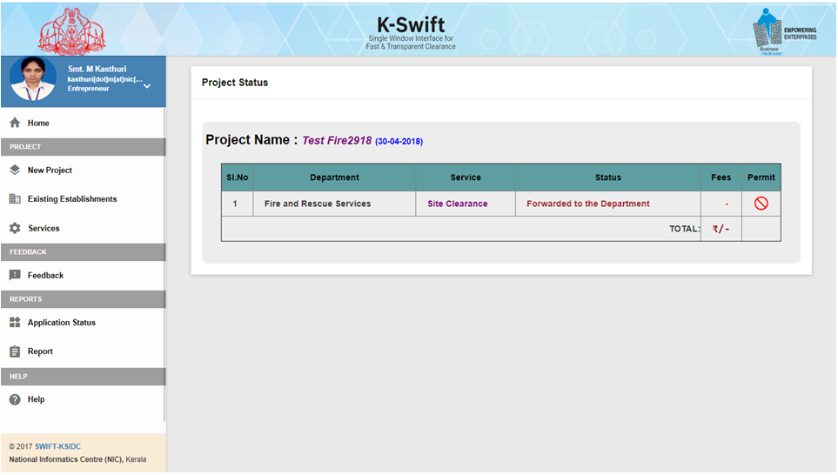
Payment

Slide 48
Dept. Process Procedure
Non-ICT Dept: Once the Fee remittance is completed, the System will automatically push the Application to the respective Depts. and the Depts will start the Application process and complete it on or before the Time line specified by the Govt.
ICT Dept: Once the Fee remittance is completed, the already submitted application will electronically move in the respective Dept. ICT environment and complete the process on or before the Time line specified by the Govt.

Slide 49
Deemed / Composite License
If the Permit / Clearance is not issued by a Dept. with in the Time Line, then the system will alert the respective Monitoring Committee and the Monitoring Committee will issue Deemed Licence with respect to that Service.
Once all the Depts. has issued the Clearance / Permit, then the respective Monitoring Committee’s will issue a Composite Certificate to the Applicant.

Slide 50
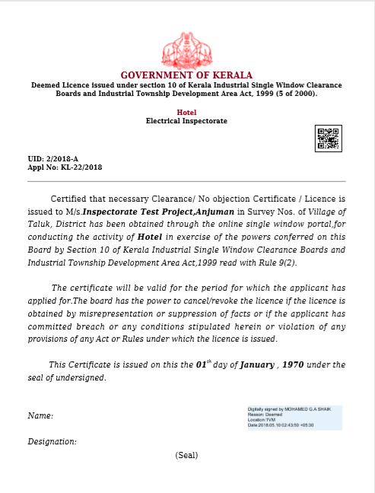
Deemed License

Slide 51

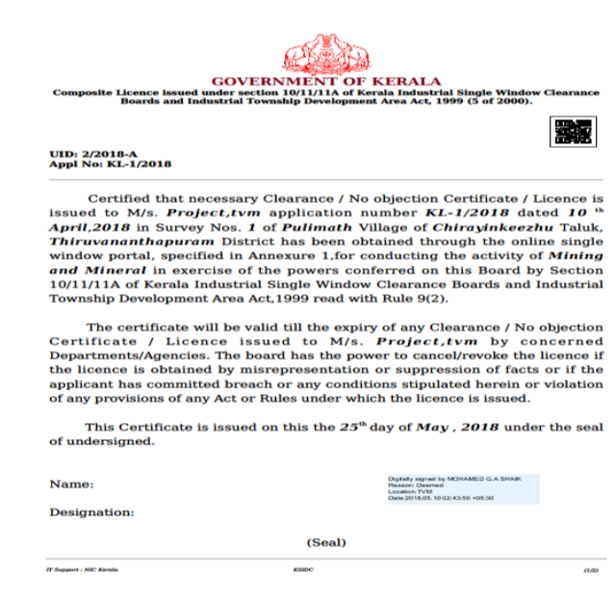

Composite License

Slide 52
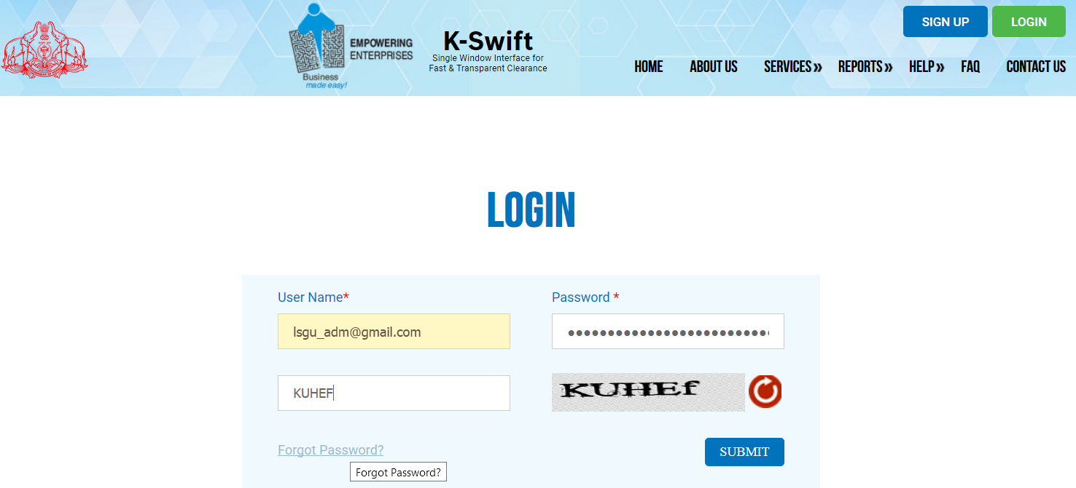
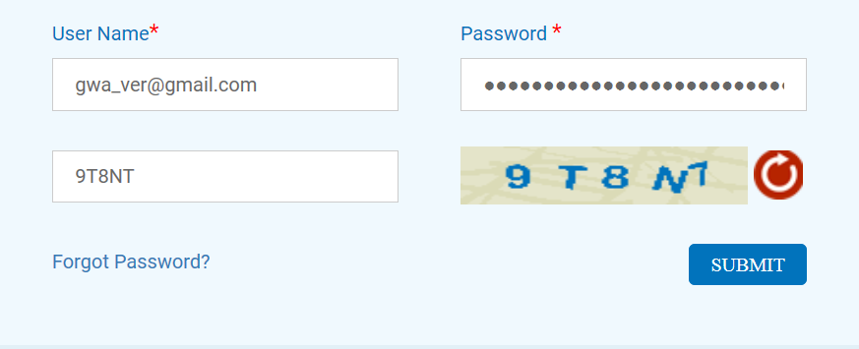
KSWIFT
www.kswift.kerala.gov.in
Role of Administrator
1. Login as Administrator
Create Role
• Admin Type
• User Type
Menu Mapping •Assign services / menu as per role
Dashboard Mapping
• Assign pillar wise dashboard
Create User/ Assign Modules
•Create User as District admin or Application user
• Assign different Module

Slide 53
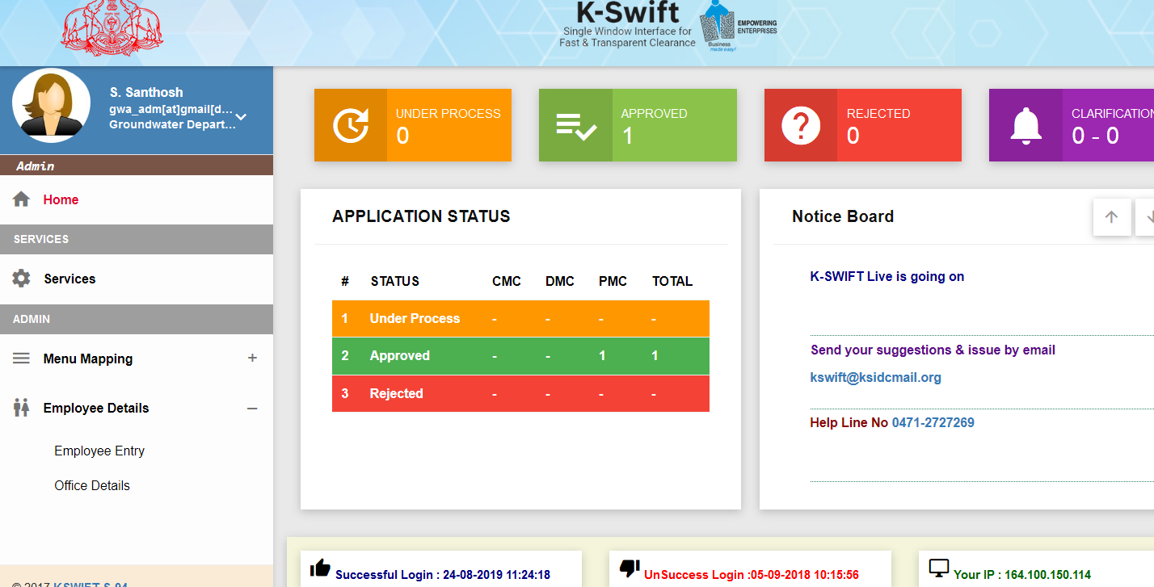
KSWIFT
www.kswift.kerala.gov.in
Home page

Slide 54
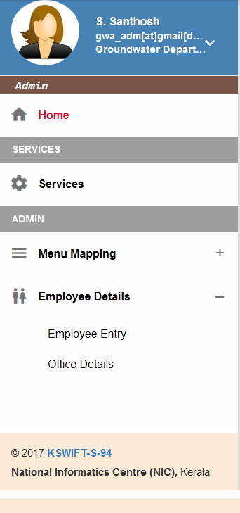
KSWIFT
www.kswift.kerala.gov.in
Roles defined
Office
Employees
OF
Directorate & District Admin
Service

Slide 55
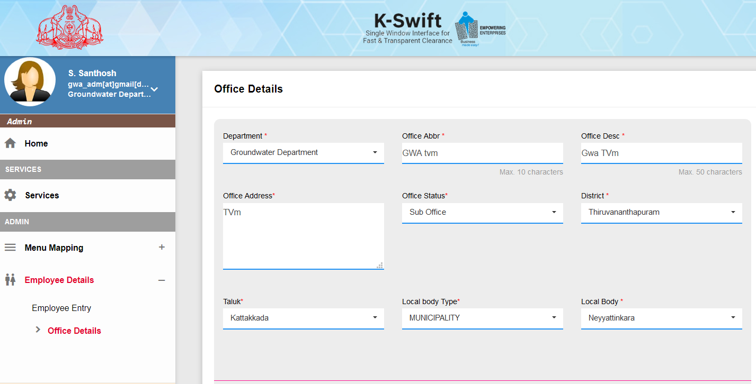
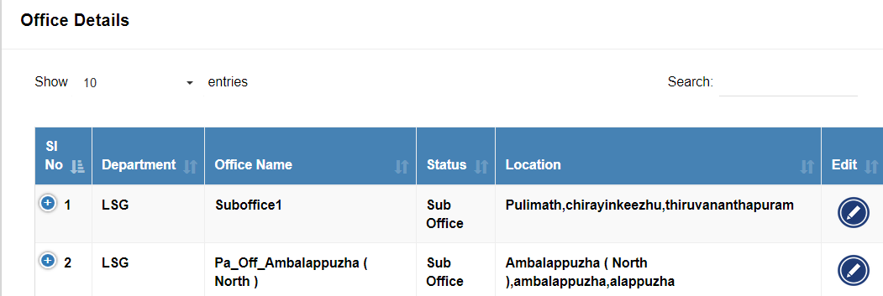
Click
KSWIFT
www.kswift.kerala.gov.in
OFFICE DETAILS

Slide 56
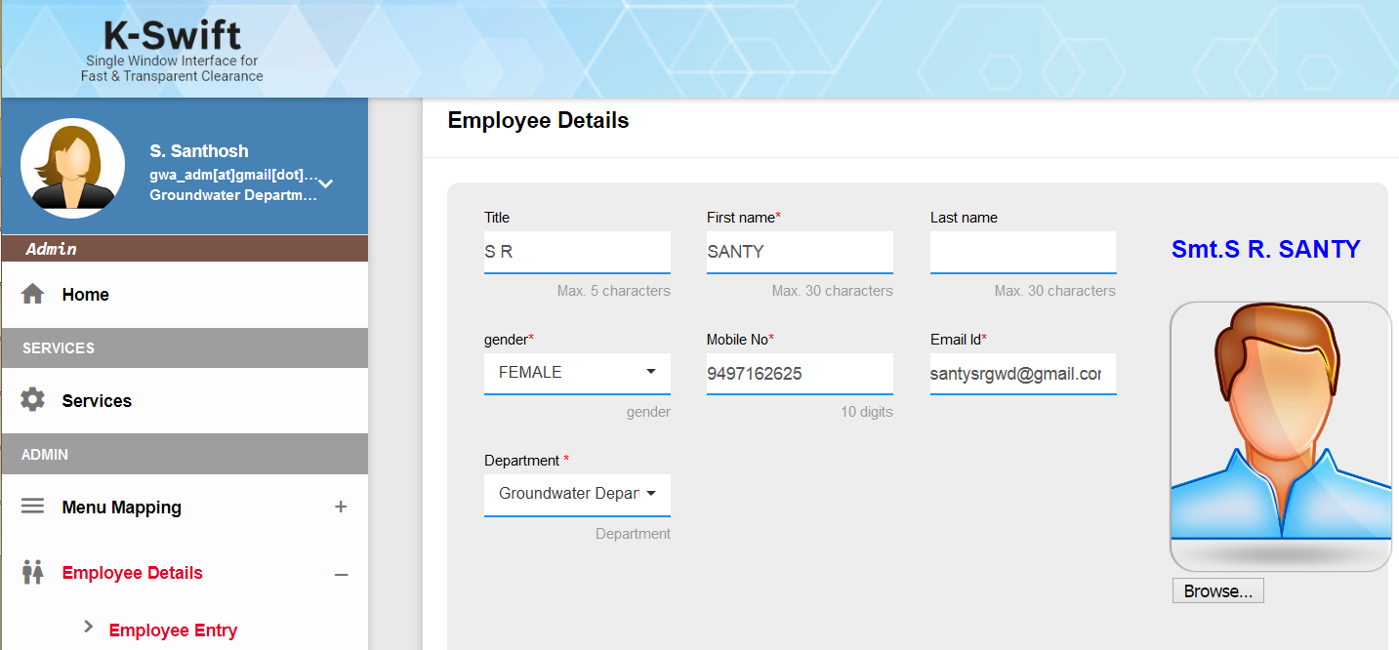
KSWIFT
www.kswift.kerala.gov.in
Administrator Home Page

Slide 57
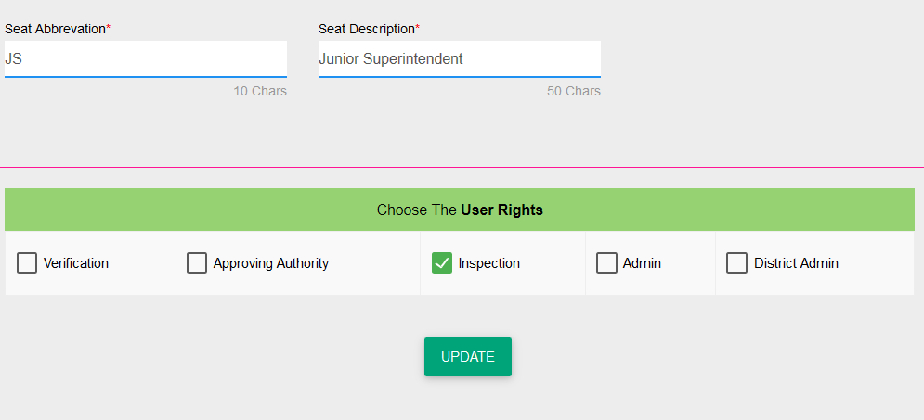
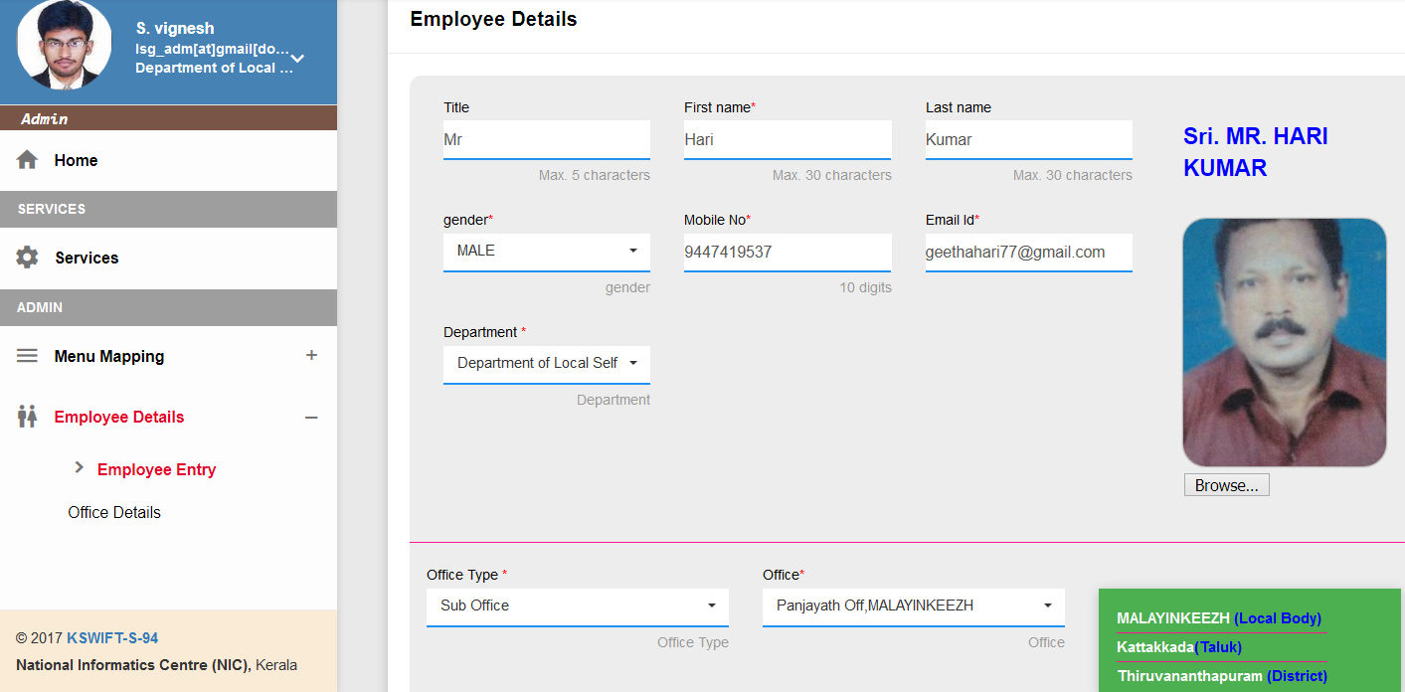

KSWIFT
www.kswift.kerala.gov.in
EMPLOYEE DETAILS
Click

Slide 58

KSWIFT
www.kswift.kerala.gov.in
SERVICE DETAILS

Slide 59
KSWIFT
www.kswift.kerala.gov.in
Role of KB officer
Selelct the application
If any notification,
Send
Take Action
either forwarding to the next level or return to the applicant

Slide 60

KSWIFT
www.kswift.kerala.gov.in
Verification officer Home page

Slide 61

KSWIFT
www.kswift.kerala.gov.in

Slide 62



KSWIFT
www.kswift.kerala.gov.in
Once the quick verification done, the application removed from the list & will be enabled for Action → see Action menu

Slide 63


KSWIFT
www.kswift.kerala.gov.in
Once the quick verification done, the application removed from the list & will be enabled for Action → see Action menu

Slide 64


KSWIFT
www.kswift.kerala.gov.in
Once the quick verification done, the application removed from the list & will be enabled for Action → see Action menu
Applicant Attached Documents List

Slide 65
KSWIFT
www.kswift.kerala.gov.in
History of reply
New Clarification
Send reply

Slide 66



KSWIFT
www.kswift.kerala.gov.in
How to take Action ?
History of reply
New Clarification
Send reply
Uploading any docs if needed

Slide 67

KSWIFT
www.kswift.kerala.gov.in
Role of BLOCK level Officer
Selelct the application
If any notification,
Send
Take Action
either forwarding to the next level or return to KB user
Login

Slide 68


KSWIFT
www.kswift.kerala.gov.in
Inspection Officer Home Page

Slide 69




KSWIFT
www.kswift.kerala.gov.in
How to take action ?
Uploading any docs if needed

Slide 70

KSWIFT
www.kswift.kerala.gov.in
Role of Approval Officer
Selelct the application
If any notification, additional payment
Take Action
either approve by using DSC or reject the application

Slide 71

KSWIFT
www.kswift.kerala.gov.in
Approval Officer Home Page

Slide 72

KSWIFT
www.kswift.kerala.gov.in
How to take Action ?
History of reply
New Clarification

Slide 73

KSWIFT
www.kswift.kerala.gov.in
How to upload permit?
History of reply
New Clarification
Send reply
Uploading any docs if needed

Slide 74

KSWIFT
www.kswift.kerala.gov.in
How to upload permit?
History of reply
New Clarification
Send reply
Uploading any docs if needed

Slide 75


KSWIFT
www.kswift.kerala.gov.in
How to upload permit?
History of reply
View uploaded
permit
New Clarification
Send reply
Uploading any docs if needed

Slide 76
KSWIFT
www.kswift.kerala.gov.in
How to upload permit?
History of reply
New Clarification
Send reply
Uploading any docs if needed

Slide 77

KSWIFT
www.kswift.kerala.gov.in
How to upload permit?
Once entered, it will be available in the entrepreneur home page
History of reply
New Clarification
Send reply
Uploading any docs if needed

Slide 78

KSWIFT
www.kswift.kerala.gov.in
How to upload permit?
If the payment is not paid , the status will be
History of reply
New Clarification
Send reply
Uploading any docs if needed

Slide 79

KSWIFT
www.kswift.kerala.gov.in
How to upload permit?
Application will be disabled , Once payment made it will be enabled for taking action
History of reply
New Clarification
Send reply
Uploading any docs if needed

Slide 80
KSWIFT
www.kswift.kerala.gov.in
How to take Action ?
History of reply
New Clarification
Send reply
Uploading any docs if needed

Slide 81

KSWIFT
www.kswift.kerala.gov.in
Attention please
Send your feed back using this option

Slide 82

KSWIFT
www.kswift.kerala.gov.in
Demo site http://demo.kswift.kerala.gov.in

Slide 83

KSWIFT
www.kswift.kerala.gov.in
Thank You all for
your kind patience
M. Kasthuri
Senior Technical Director & Scientist-F
National Informatics Centre
(Kerala State Centre)
Thiruvananthapuram
Kasthuri.m@nic.in

